Slide 1
Zynq PS/PL and Kernel Module
Zynq PS/PL and Kernel Module
Roger D. Pease
https://www.yourembeddedsoftwaredesigner.com
rogerpease@gmail.com

Slide 2
Kernel Developer Challenges
Developing a kernel module for legacy hardware is often difficult because:
  The hardware is immediately critical to the system functionality.
  The established kernel code is directly compiled into the kernel.
  The hardware specifications are not easily available.
This project enables me to build my own hardware peripheral on a Zynq 7000 device and then interface with the peripheral through the kernel.

Slide 3
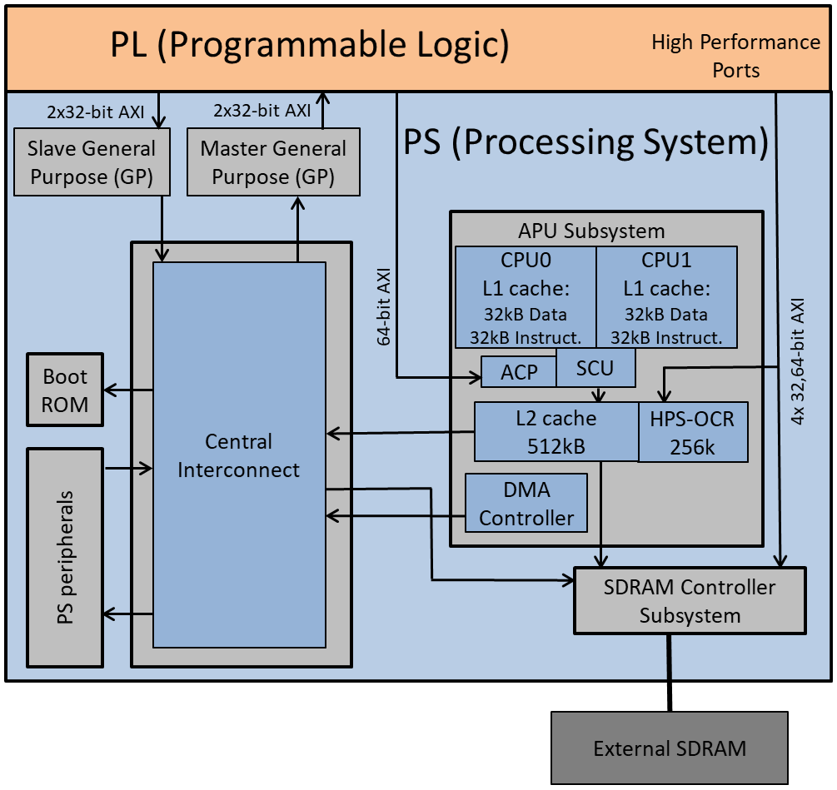
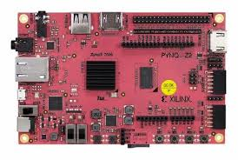
The Zynq 7000 Chip
This is a small FPGA that can be configured into a peripheral.
Two-core ARM CPU

Slide 4
What will we do
Design and Build the Peripheral
Design the kernel module
Demo

Slide 5
What we will need:
Zynq board (see https://www.pynq.io/boards.html)
Vivado for the FPGA Image
Linux Kernel source (you need the exact same) configuration.

Slide 6
Design and Build Peripheral
The peripheral is a simple RPN Stack-based calculator.
RPN pushes elements onto a stack and then pulls them off when you do an operation. 5 + 10*7 would be:
Stack Element | Push 5 | Push 10 | Push 7 | Multiply | Add | Pop | Final
Elem 2 | Empty | Empty | Empty | 5 | Empty | Empty | Empty
Elem 1 | Empty | Empty | 5 | 10 | 5 | Empty | Empty
Elem 0 | Empty | 5 | 10 | 7 | 70 | 75 | Empty

Slide 7
Register Layout
Register | Meaning
0x0 (RW, resets to 0) | Integer Value to push on stack
0x4 (W, default to 0) | Operation: 0 means do nothing 1 means reset 2 means push value in 0 to stack 4 means pop 8 means add 16 means subtract 32 means multiply
0x8 (R, reset to 0) | Value on Stack element 0.
Since this is a Linux group I won’t bore you with the Verilog source code
and FPGA Image generation.

Slide 8
Now for the Kernel
In this case r5u10u7uma represents 5+10*7
^{import os}
fh = os.open(“/dev/zynqrpn0”, os.O_RDWR)
^{os.write(fh,”r5u10u7uma”)}
^{result = os.read(fh,10)}
^{os.close()}
^{Open /dev/zynqrpn0}
Write “r5u10u7uma” and read the result
^{Close /dev/zynqrpn0}

Slide 9
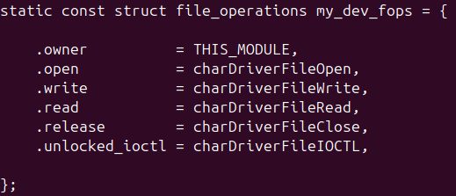
Kernel Module
^{#!/usr/bin/env python3}
fh = os.open(“/dev/zynqrpn0”, os.O_RDWR)
^{os.write(fh,”r5u10u7uma”)}
^{result = os.read(fh,10)}
^{os.close()}
Making these calls in user space calls the corresponding function at the kernel.

Slide 10
How do we access the peripheral
Registers are memory mapped.
The base address in this case is 0x40000000.
In a superloop implementation you would just use a pointer.
  uint32_t *stackpushvalue = (uint32_t *) 0x40000000;
  *stackpushvalue = 0x00000005;
In the kernel you use ioremap/writel:
  void __iomem *stackpushvalue = ioremap(0x40000000, 4);
  writel(0x00000005,stackpushvalue);
  iounmap(stackpushvalue);

Slide 11
The Kernel Module contains:
Init and remove functions called at insmod/rmmod time.
The init module registers the character device and maps the character functions to the file_operations.
The writes to/reads from the peripheral (in this case) happen during read()/write().
For a more complicated peripheral you might need to set up interrupts/schedule work/allocate memory/etc.

Slide 12
Compiling
The module compile on the embedded system itself was not working.
In order to cross-compile, you need a build of the *exact same* kernel you intend to run on.
I ended up going on to Xilinx’s website a copy of the kernel build they used. I then took the config file from the Zynq board and used that to compile.

Slide 13
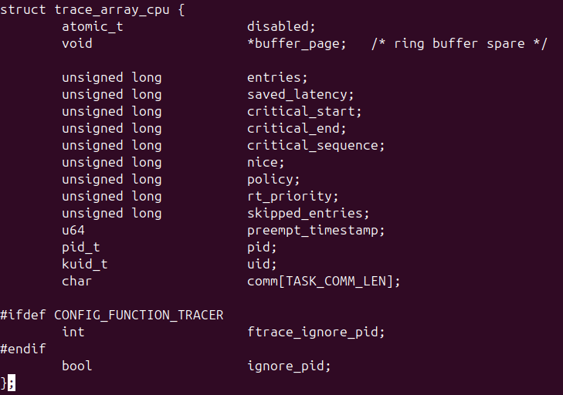
Why the kernel needs to be the same
The modules have access to many of the other symbols of the kernel plus the headers.
This is set by the kernel .config.
struct trace_array_cpu *myptr;
myptr→ignore_pid
will be different depending on that configuration option.

Slide 14
Steps to get us working:
Program the PL.
Insert the kernel module into the kernel.
mknod the character device
Read and write from the character device.

Slide 15
Code is available:
https://www.yourembeddedsoftwaredesigner.com
Includes links to GitHub source code and a Vivado tutorial.

